Slide 1
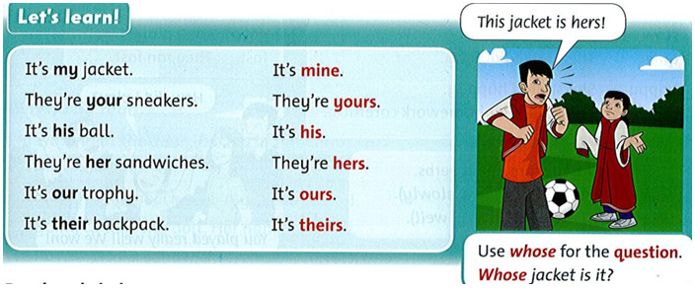
Monday , December 1th 2021 Unit 6: Whose jacket is this? Lesson 2
1. Listen to the story and repeat. Act.
2. Listen and repeat.
Click here to listen

Slide 2
It's my jacket. They're your sneaker. It's his ball. They're her sandwiches. It's our trophy. It's their backpack. | It's mine. They're yours. It's his. They're hers. It's ours. It's theirs.

Slide 3
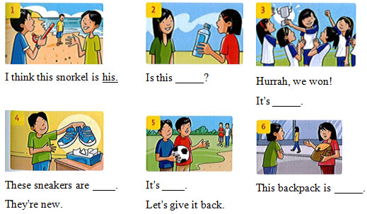
3. Read and circle
1. This sandwich is my / mine. | 4. This is our / ours trophy.
2. The red sneakers are her / hers. | 5. That backpack was their / theirs.
3. There are five players in my /mine team. | 6. Is this your / yours jacket?
4.Write: mine his hers yours ours theirs

